Slide 1
JAVASCRIPT UNIT TESTING JEST, MOCHA TDD, BDD
Kyrylo Abramov

Slide 2
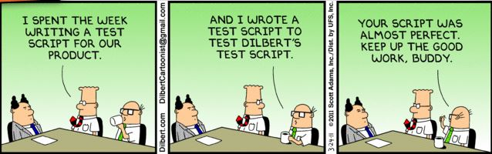
JAVASCRIPT UNIT TESTING
WHY TESTING?
TDD
BDD
JEST, MOCHA

Slide 3
UNIT TESTING
Unit testing - is a type of testing which is found at the bottom of the software testing pyramid. It involves breaking the codebase down into smaller parts (or units) and testing those in isolation.
Depending on the type of programming language (or paradigm) these can be against anything you define as a unit, although the most common practice is against functions.

Slide 4
WHY TESTING?
Protection - Unit testing protects against introducing new or old bugs for defensive programming
Confidence - You can add changes, or reuse or refactor code (both very common) and be sure you haven’t added a bug
Documentation - Unit testing documents the behavior and flow of code so its easy for someone new to the code to understand it
Isolation - It isolates a module from the entire feature. This approach forces you to think of a module by itself, and ask what is its job?
Quality - As unit testing forces you to think about and use your own API, it enforces good/extendable interfaces and patterns. It can point out any tight coupling or over-complexity which should be addressed. Bad code is usually much harder to test
Industry Standard - Unit testing is a common discipline these days, and is a requirement for a large portion of software companies
Fewer bugs - Substantial research suggests that applying testing to an application can reduce production bug density by 40% — 80%.

Slide 5
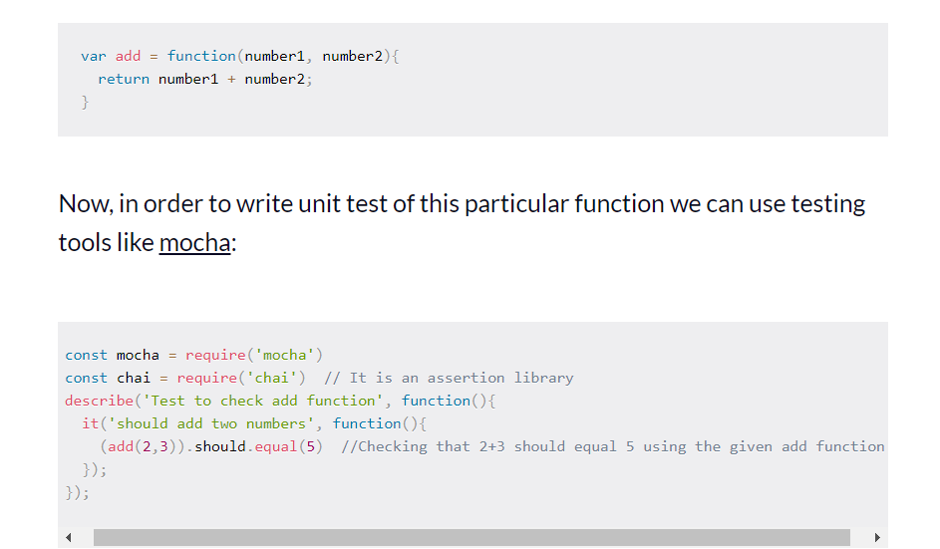
EXAMPLE IN JAVASCRIPT

Slide 6
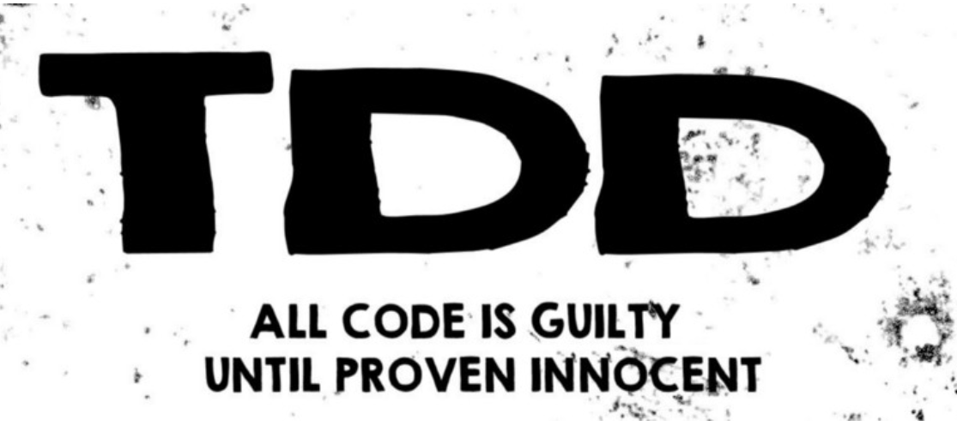
TDD
TDD is often described as a
Red
Green
Refactor cycle
RULES:
Write only enough production code to make the failing unit test pass.
Write only enough of a unit test to fail.

Slide 7
RFR FASES
RED FASE:
This is the phase where you design how your code will be used by clients.
You have to write a test that uses a piece of code as if it were already implemented.
You write a test so that you can then write production code. You don’t write a test to test your code.
LeapYear.spec.jsdescribe('Leap year calculator', () => {
it('should consider 1996 as leap', () => { expect(LeapYear.isLeap(1996)).toBe(true); });});
The name of the leap year calculator is LeapYear
isLeap(...)is a static method of LeapYear
isLeap(...) takes a number (and not an array, for example) as an argument and returns true or false .

Slide 8
RFR FASES:
GREEN FASE:
In this phase, you need to act like a programmer who has one simple task: write a straightforward solution that makes the test pass (and makes the alarming red on the test report becomes a friendly green).
In this phase, you are allowed to violate best practices and even duplicate code. Code duplication will be removed in the refactor phase.
TODO LIST:
Feature: Every year that is exactly divisible by four is a leap year, except for years that are exactly divisible by 100, but these centurial years are leap years if they are exactly divisible by 400.
-divisible by 4- but not by 100- years divisible by 400 are leap anyway
The to-do list is live: it changes while you are coding and, ideally, at the end of the feature implementation it will be blank.

Slide 9
RFR FASES
REFACTOR FASE:
In the refactor phase, you are allowed to change the code, while keeping all tests green, so that it becomes better. What “better” means is up to you.
But there is something mandatory: you have to remove code duplication.
In the red phase, you’re showing off your skills to your users.
But in the refactor phase, you’re showing off your skills to the programmers who will read your implementation.

Slide 10
JEST
Jest is a JavaScript test runner, that is, a JavaScript library for creating, running, and structuring tests.
Jest ships as an NPM package, you can install it in any JavaScript project.
Jest is one of the most popular test runner these days, and the default choice for React projects.

Slide 11
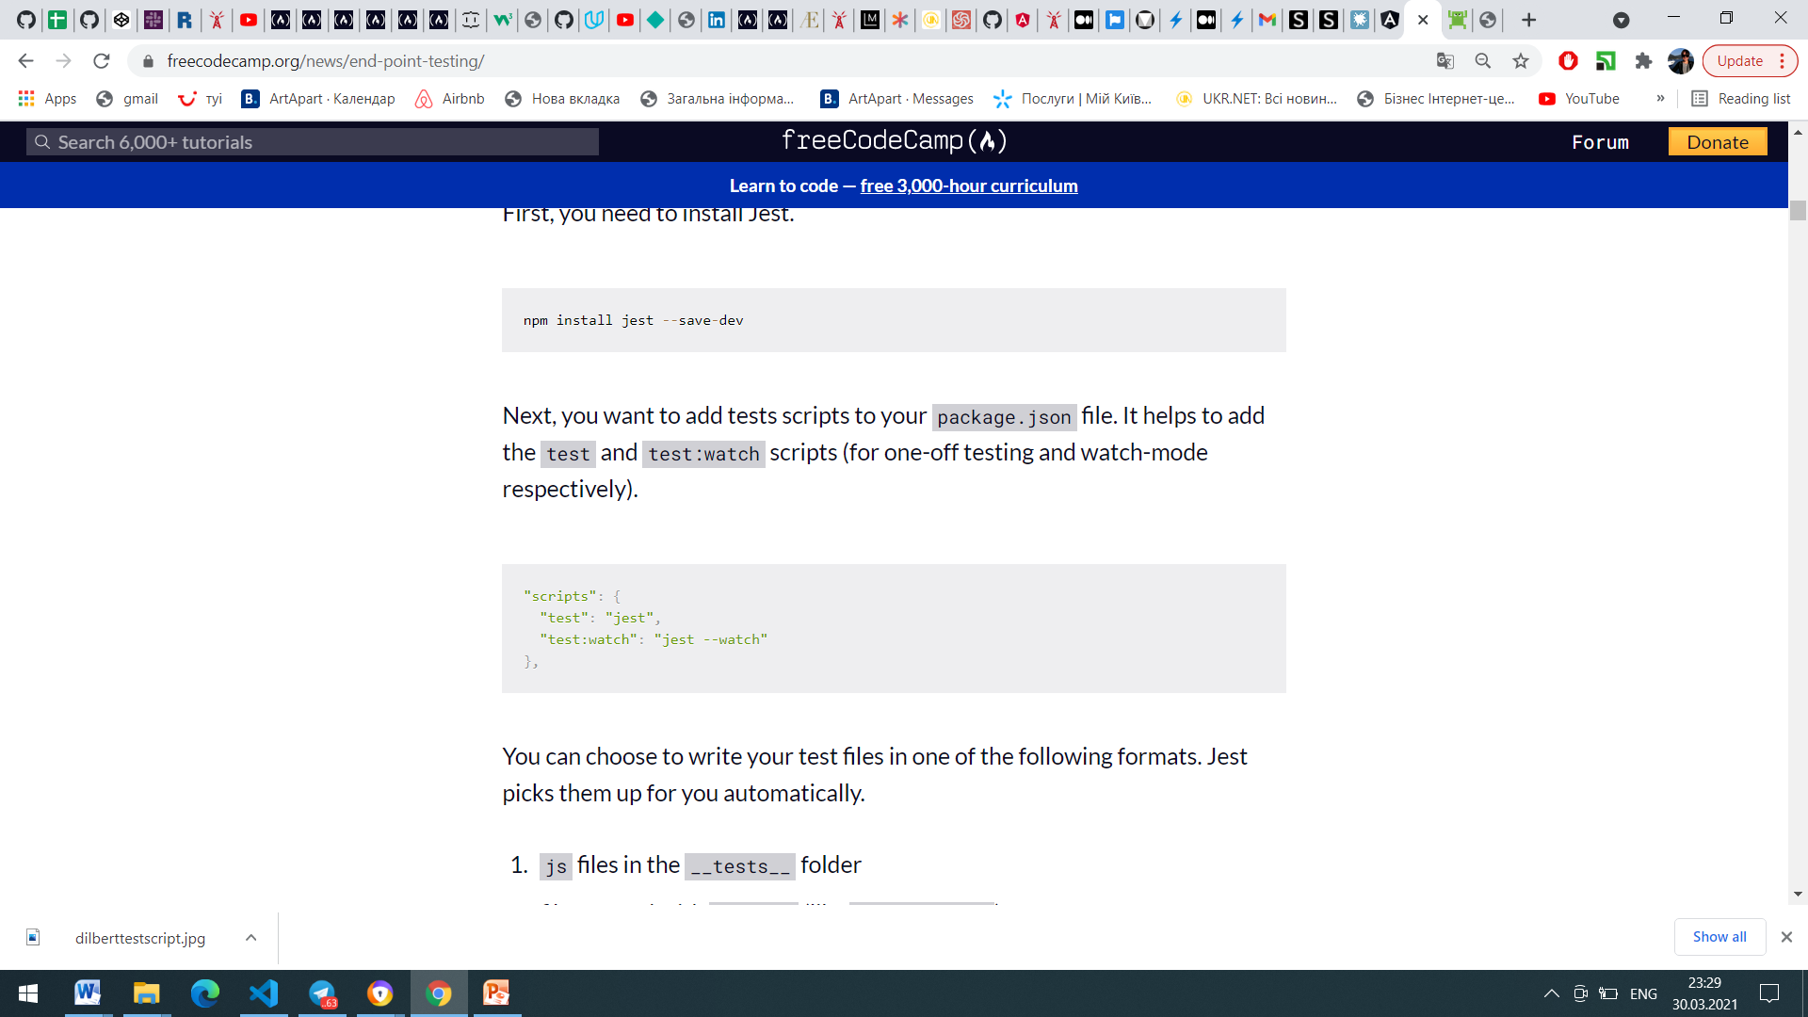
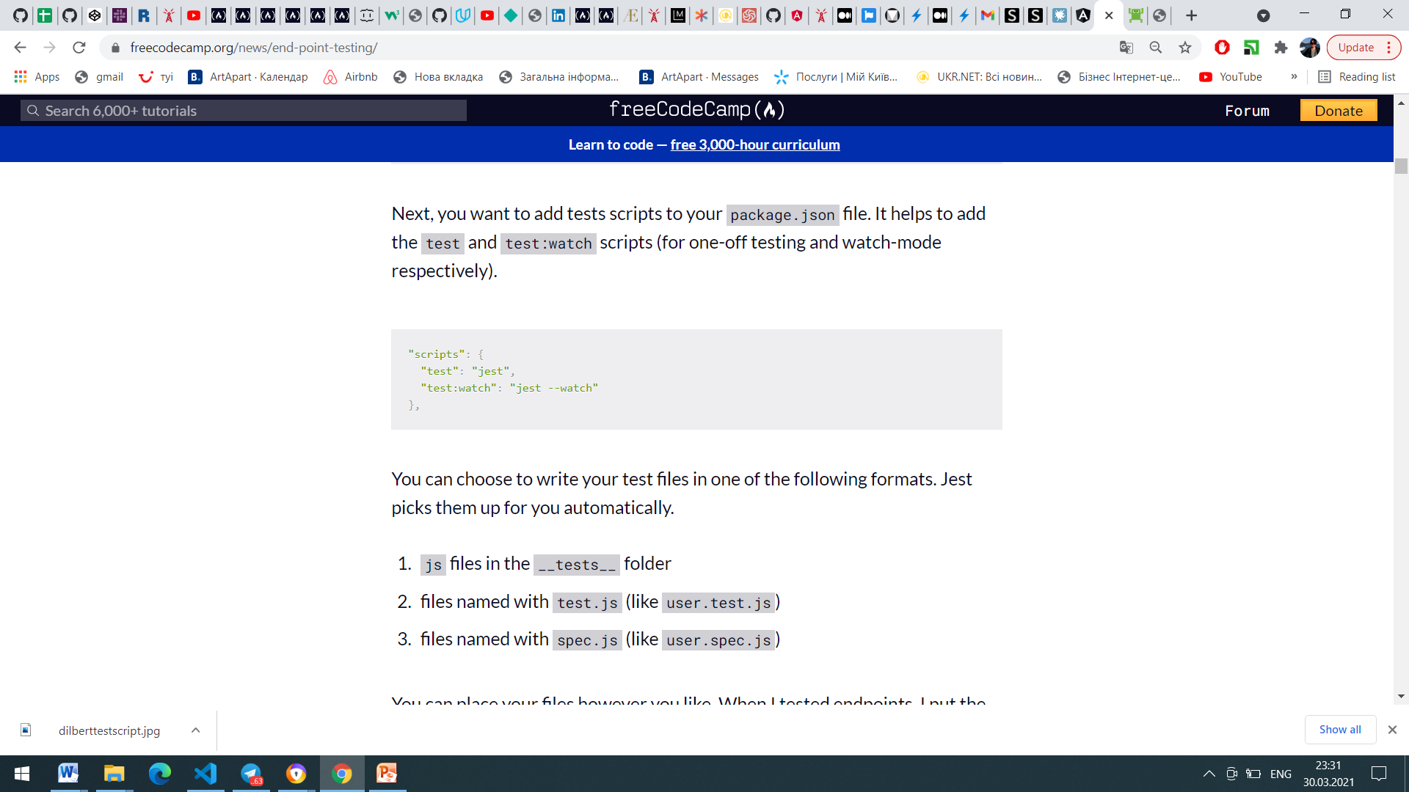
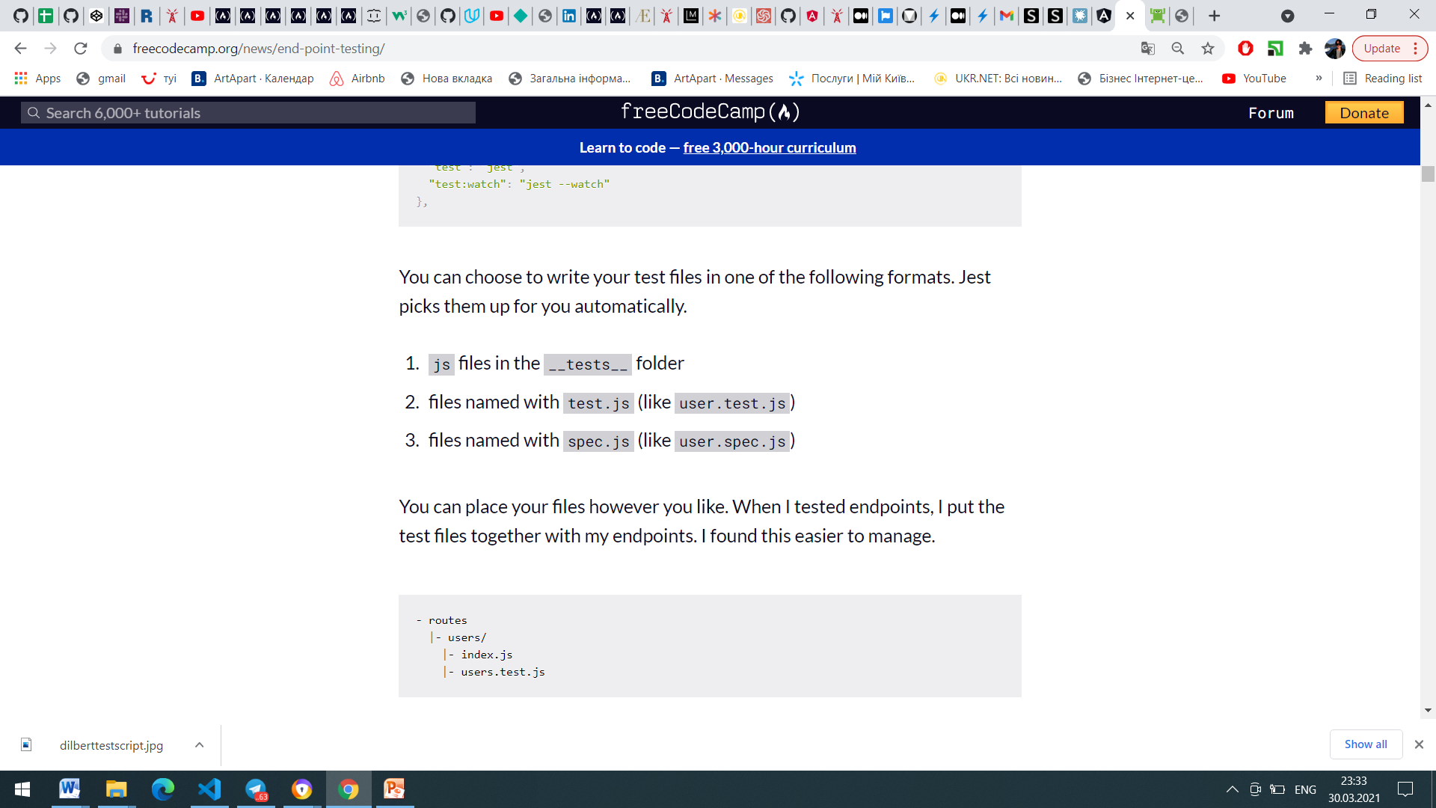
JEST SETUP

Slide 12
WRITING TEST
Jest includes describe, it and expect for you in every test file. You don't have to require them.
describe lets you wrap many tests together under one umbrella. (It is used for organizing your tests).
it lets you run a test.
expect lets you perform assertions. The test passes if all assertions passes.

Slide 13
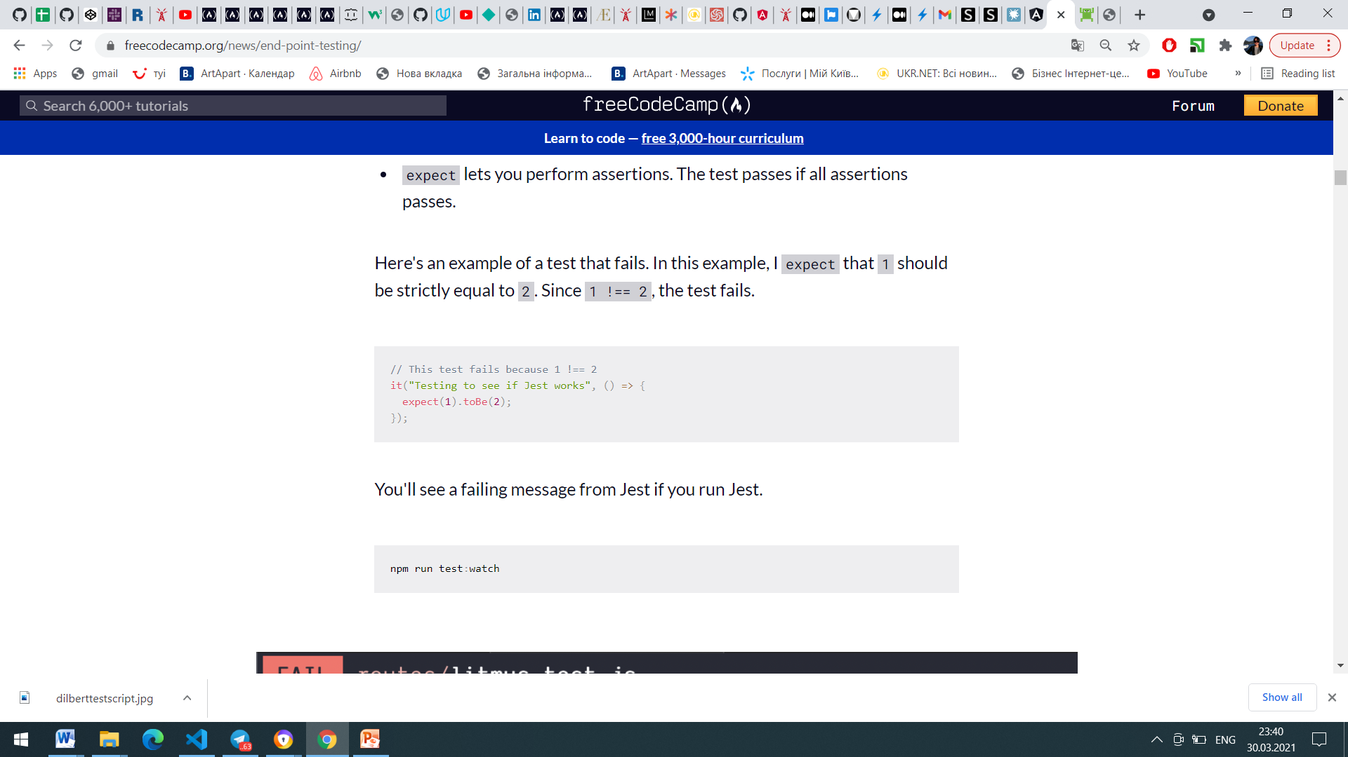
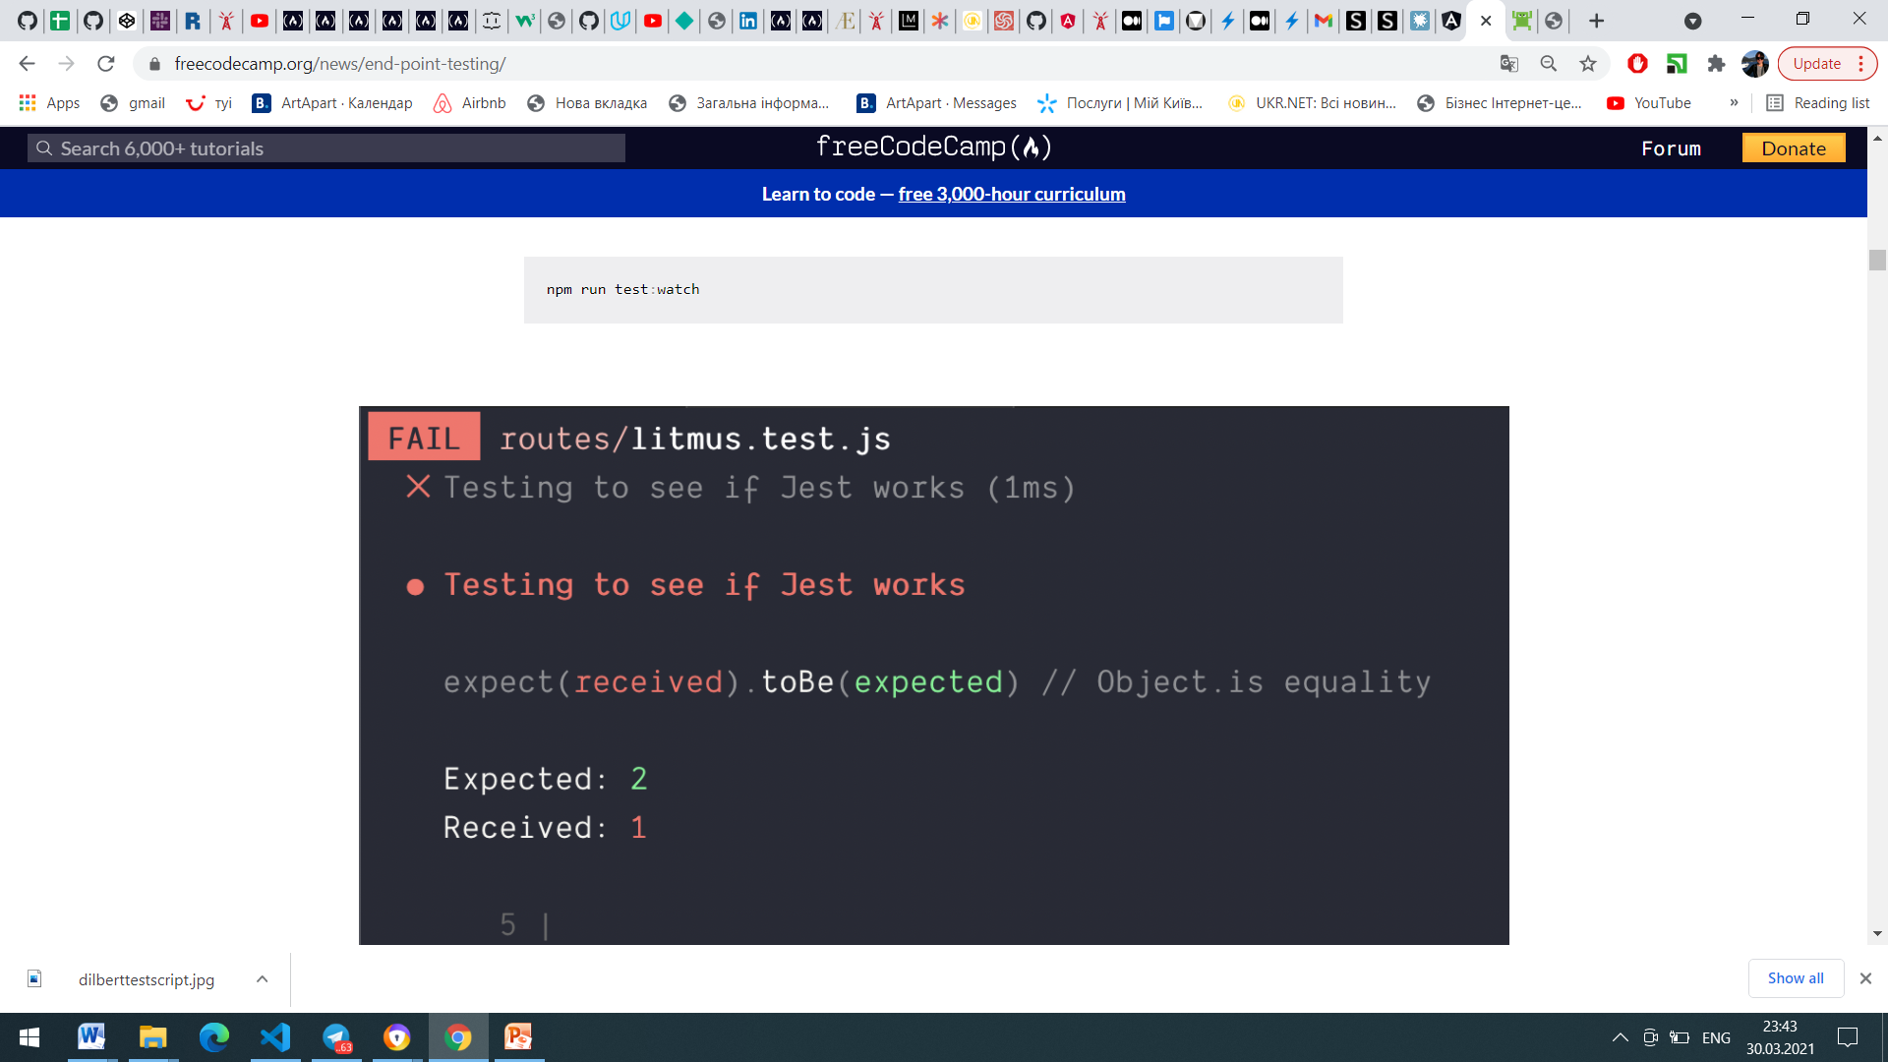
WRITING TEST

Slide 14
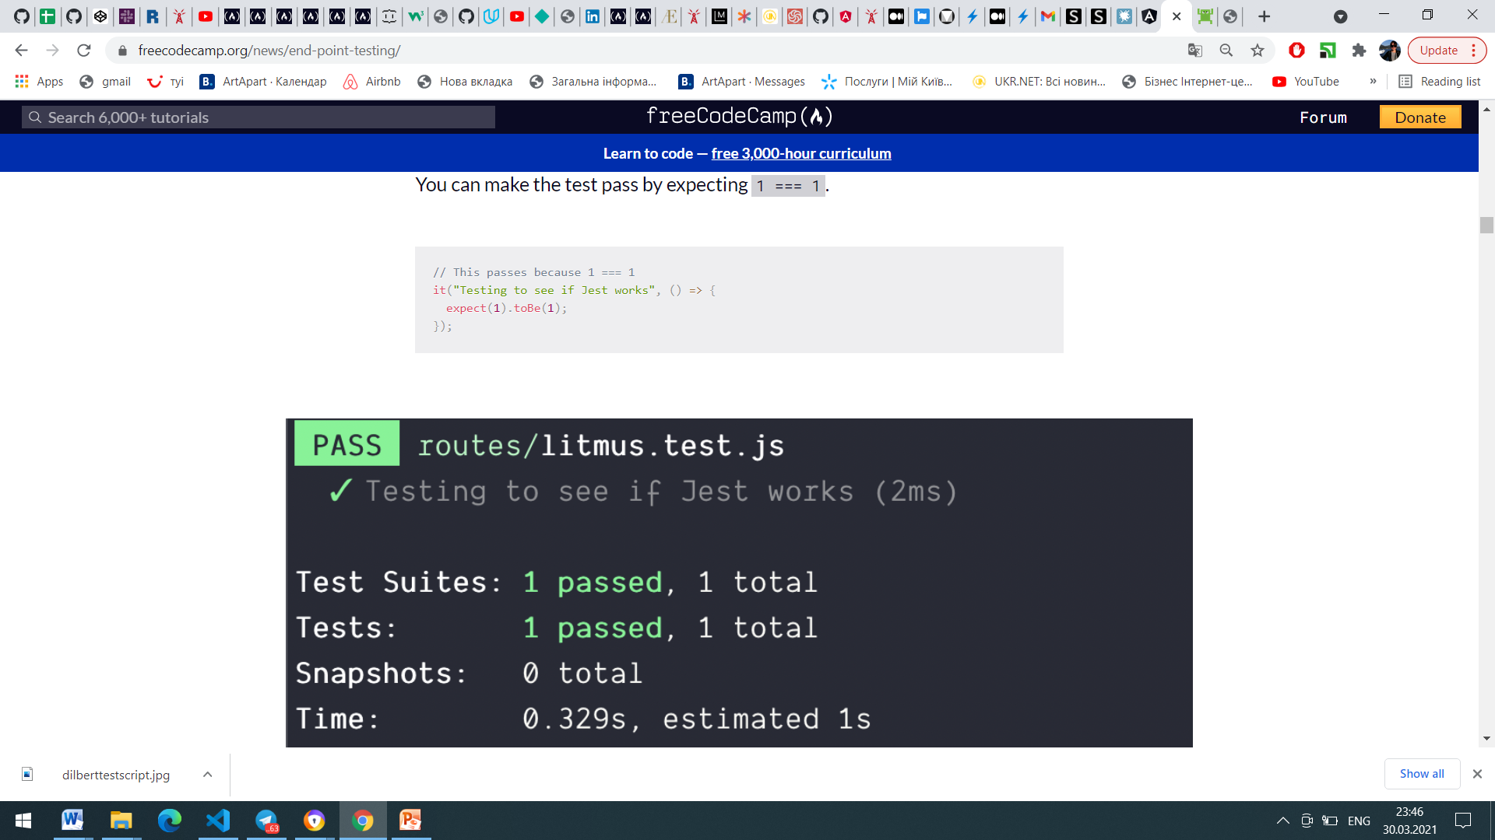
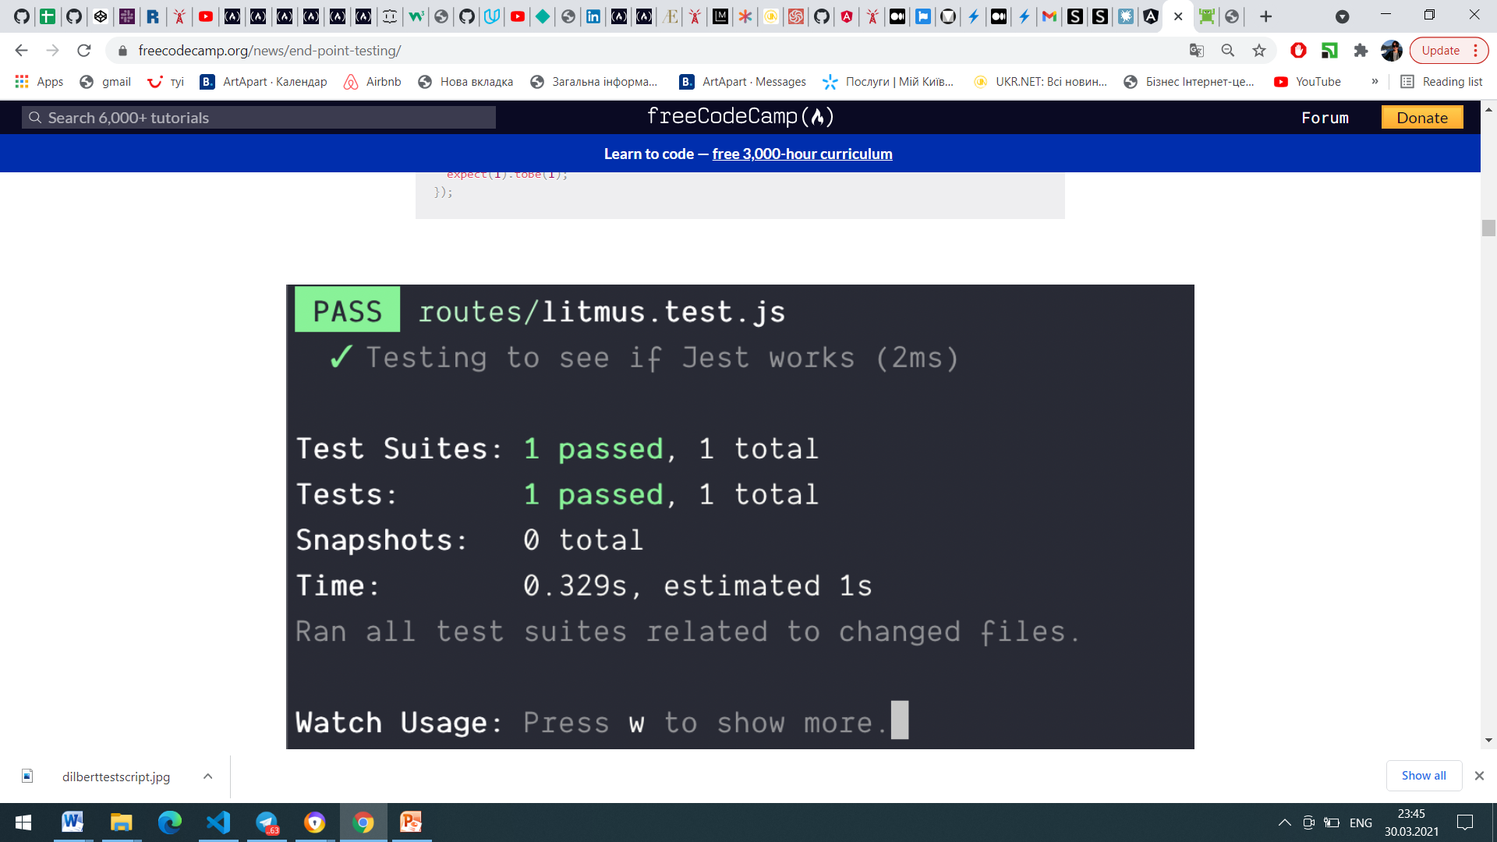
WRITING TEST

Slide 15
MOCHA
Mocha.js is an open-source JavaScript test framework that runs on Node.js and in the browser. It’s designed for testing both synchronous and asynchronous code with a very simple interface.
Mocha.js provides functions that execute in a specific order and logs the results in the terminal window. It also cleans the state of the software being tested to ensure that test cases run independently of each other.
While it can be used with most assertion libraries, Mocha.js is commonly used with Chai, a popular assertion library for Node.js and the browser.

Slide 16
BDD & MOCHA
Behavior-driven development (BDD) aims to help developers build software that is predictable, resilient to changes, and not error-prone. It evolved from test-driven development (TDD), which requires you to:
Write tests for the required software functionality
Run the tests for the software functionality
Implement the software functionality
Fix bugs and refactor until all tests pass
Repeat the cycle for any new functionality
The main difference between TDD and BDD is that BDD calls for writing test cases in a shared language to simplify communication between technical and nontechnical stakeholders, such as developers, QA teams, and business leaders.

Slide 17
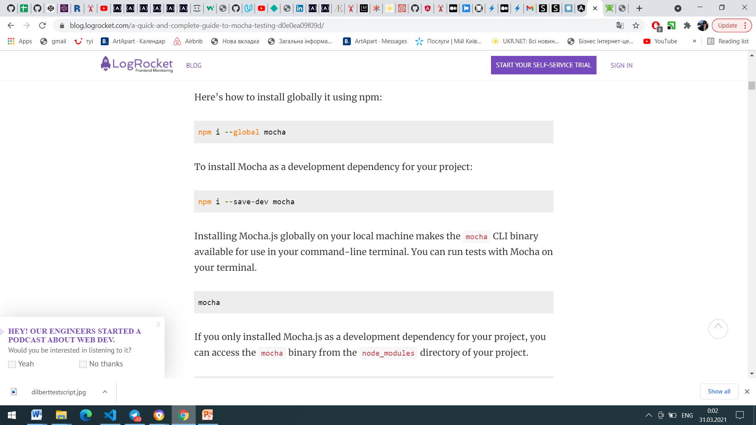
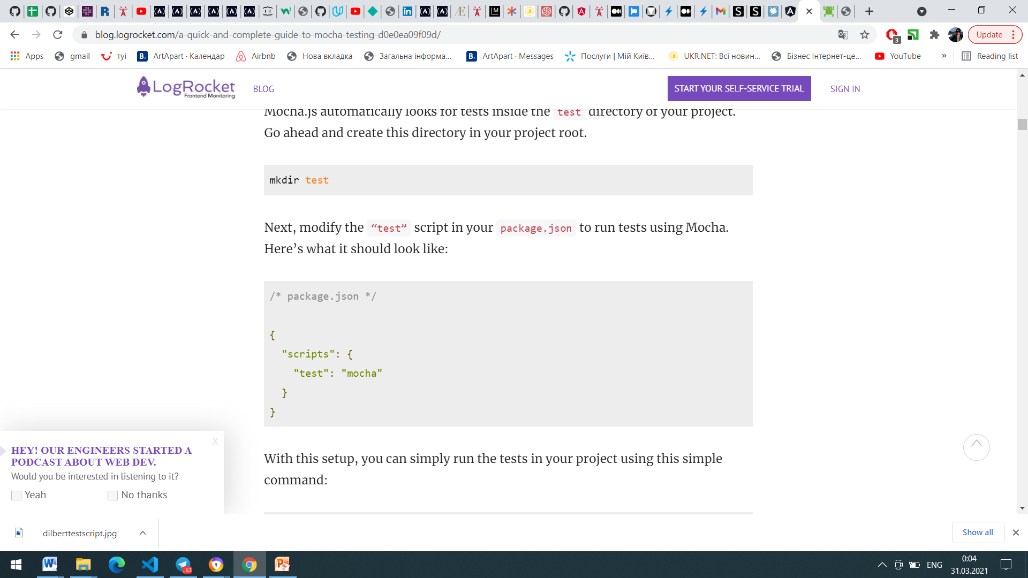
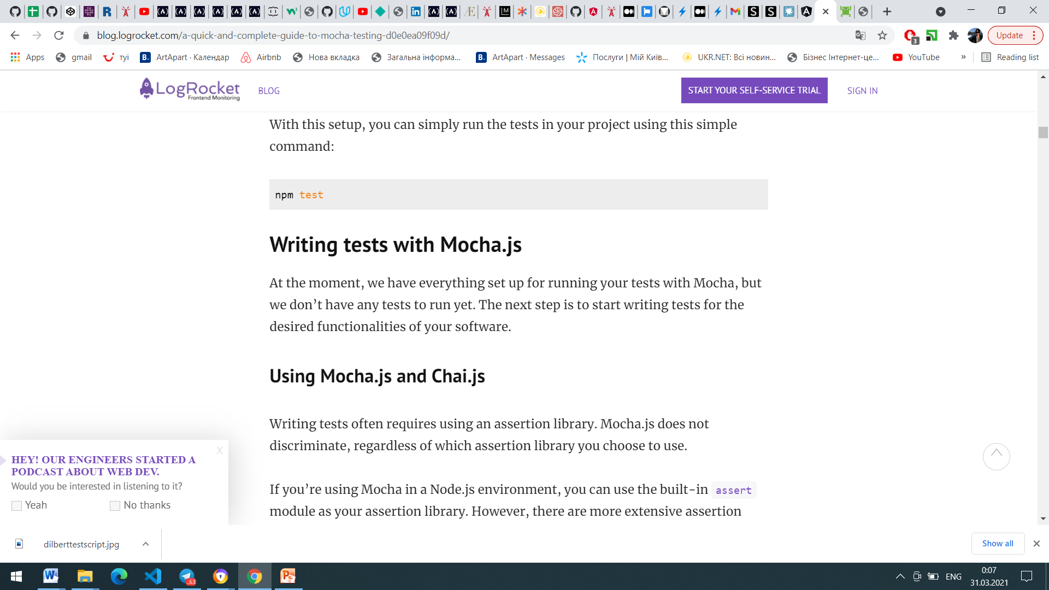
MOCHA SETUP

Slide 18
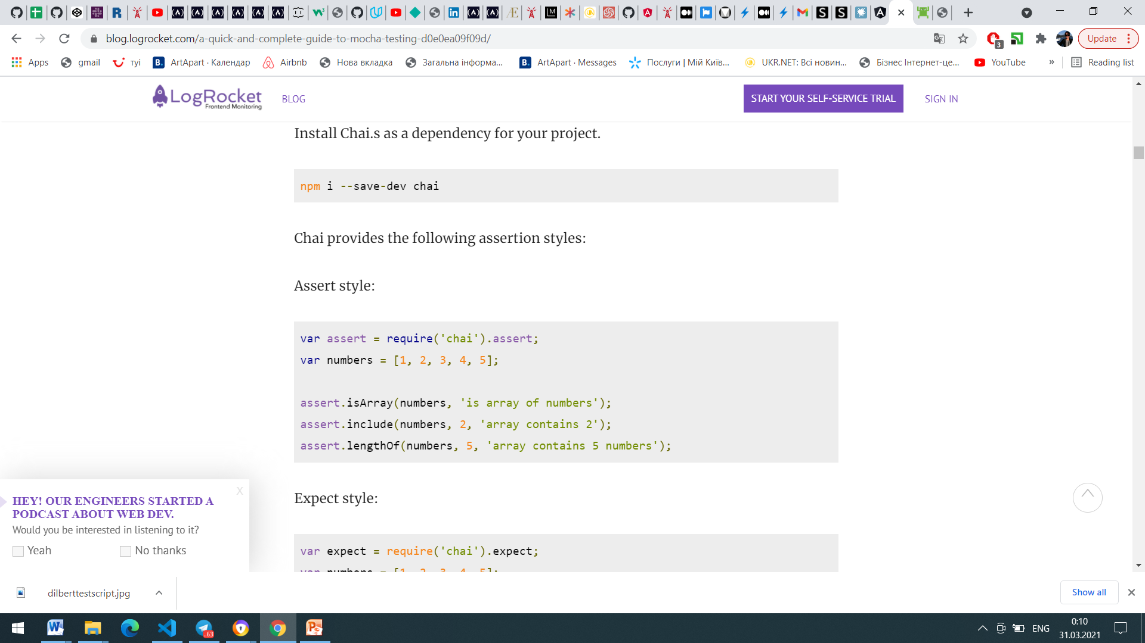
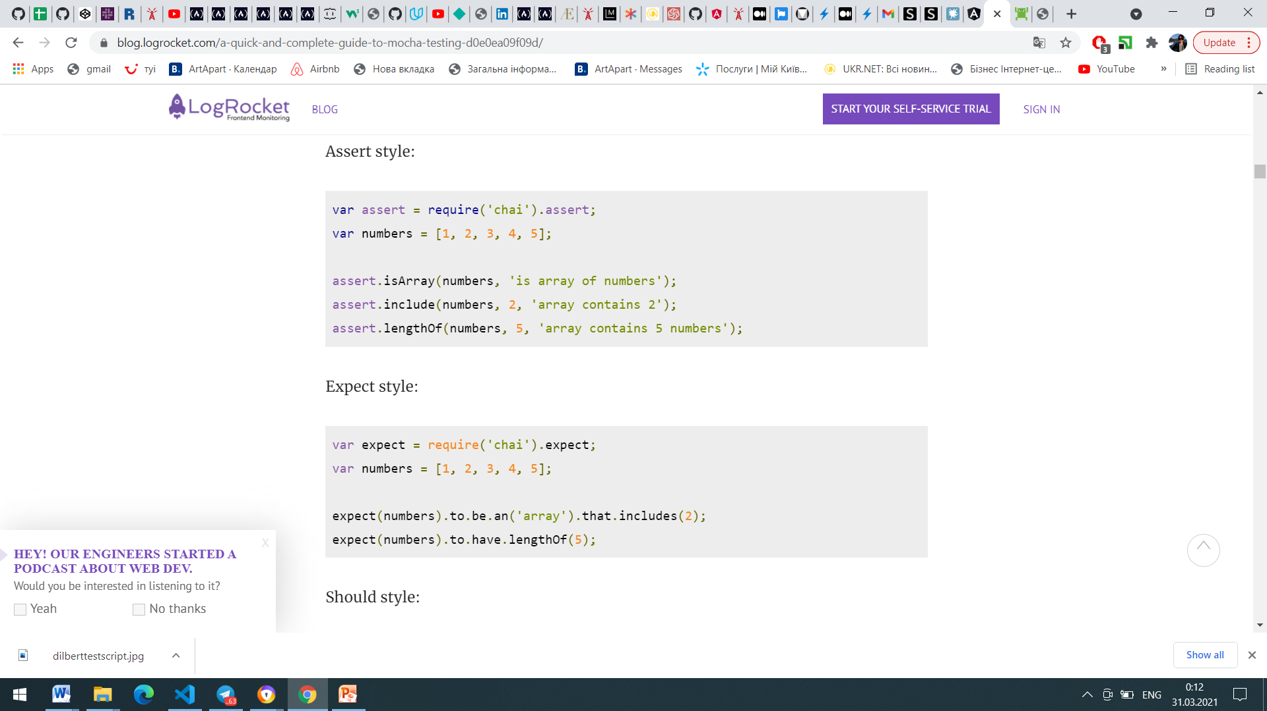
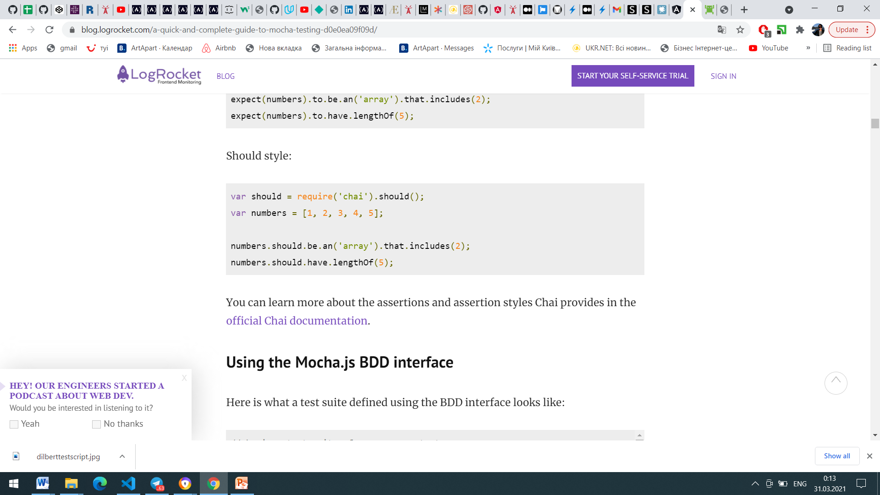
CHAI

Slide 19


